Slide 1
Wireless Power Receiving Unit Analysis, design and implementation of inductive power receiving unit for wireless circuits
Master Thesis Presentation Electronics and Computer Technology (Microelectronics)
2. Nov. 2017
Rikesh Chauhan

Slide 2
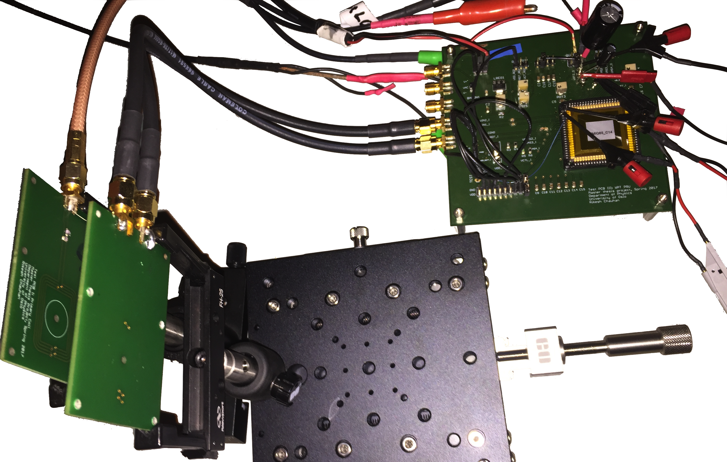
Outline
Motivation
Background
Component Design
PMS Chip
WPT System
Measurement and Verification
Conclusion

Slide 3
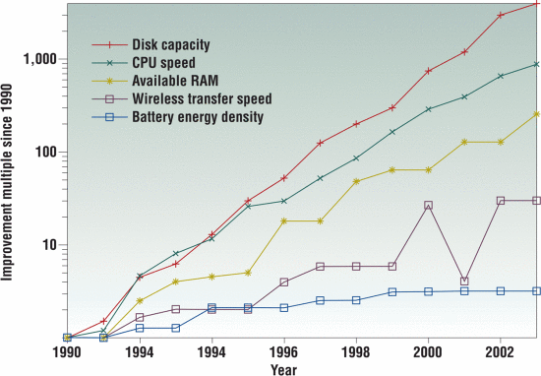
Motivation
Technology Trend:
Size and weight
Transistor, IC
Operation
Multifunction, high speed
Multi-core, SoC, IoT
Power consumption
Low power
Shrinking size, low Vdd
Dynamic voltage scaling
Operation modes: sleep,
nap, doze, active
Power supply (?)
Major constraint
Significant proportion of size and weight
Regular recharge, replacement

Slide 4
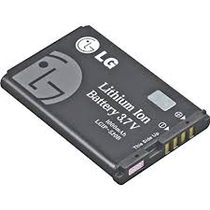
Motivation
Power supply/Battery
Volumetric energy density
Gravimetric energy density
Reduced self discharge
Increased charge cycle
Lithium-ion battery mostly used
Research (MORE ON IT)
Energy Harvesting
Ambient energy source
Wireless Power Transfer
Available reliable source

Slide 5
Background: Energy Harvesting
Perpetual energy source
Harvesting: Energy source => Transducer => Power Management
Mostly used 3 types depending on energy source:
Kinetic: Mechanical deformation, Piezoelectricity
Thermal: Thermocouple, Seeback effect
EM: Solar cell, Photoelectric effect

Slide 6
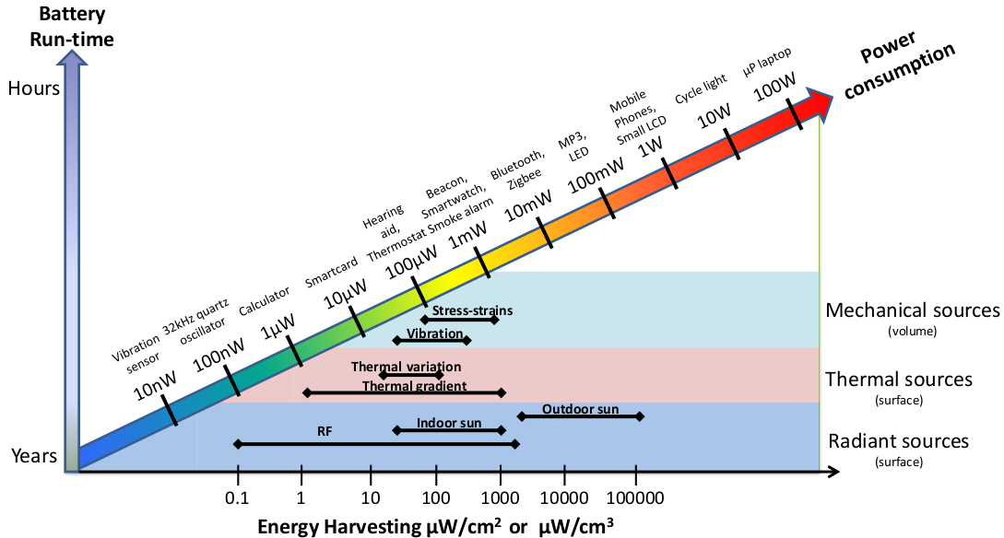
Background: Energy Harvesting
Low power, low power density
Applicable to LP sensors
Not feasible for devices with power >1 mW
If so how about convenient use of already available power ?

Slide 7
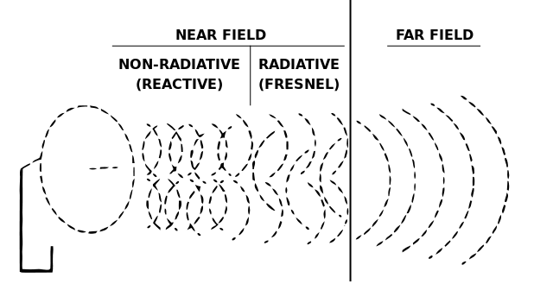
Background: WPT
Cut the cord
Minimize most of the constraints
Reduced size and weight
Water proof, dust proof
Reduced accidents
Transfer distance boundary λ/2π
Two types depending on transfer distance:
Near-field, < λ/2π
Non-radiative
Magnetic field
No RF exposure
Far-field, > λ/2π
Radiative
Electric field
RF exposure

Slide 8
Background: WPT, Near-field
Inductive power transfer
Weakly coupled, mm in range
Magnetic resonance inductive power transfer
Improved coupling, cm in range
Simultaneous multiple receiver
Capacitive power transfer
Limited due to large plates, close coupling requirement

Slide 9
Background: WPT, Far-field
Non-directive
Use of isotropic EM wave
Non-directive antenna
Directive
Use of beam forming
Dedicated directive Rx and Tx
Health concern, exposure to high power RF wave
New possibilities:
Can transmit both data and energy simultaneously
Solar Power Satellite, Stationary High Altitude Relay Platform

Slide 10
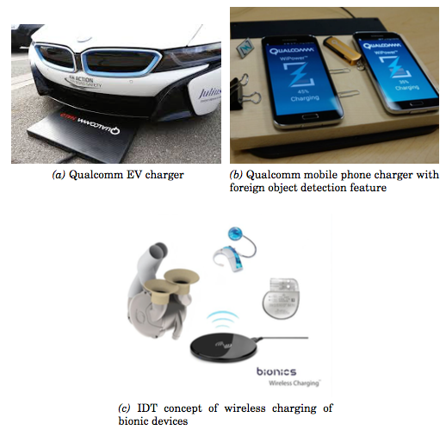


Background: WPT, Applications and Standards
IPT/MR-IPT application
Industrial automation
Automotive
Consumer electronics
Medical implants
Qi
IPT and MR-IPT
Communication and transfer: 80-300 KHz
A4WP
MR-IPT
Communication: 2.4 GHz, Transfer: 6.78 MHz
AirFuel
A4WP + PMA

Slide 11
Background: This Project
Pilot project for Nordic Semiconductor
Resonance inductive coupling
Most efficient method so far
90 nm CMOS process, 2.5 V devices
Design challenge, in literature mostly in higher technology nodes
13.56 MHz operating frequency
Load: 10 mA @1.8V

Slide 12
Rectifier: Gate cross coupled with RCC
Gate cross coupled full wave active rectifier
Comparator with reverse leakage control (RCC)
Voltage drop conduction only
Less conduction drop => increase VCE
RCC => increase PCE
Self power start-up
VCOM high when
V_{in1} – V_{in2} > V_{rec}
M8 for RCC

Slide 13
Rectifier: Transient Simulation
+ve cycle: Vin1 > Vin2, Vin = Vin1 – Vin2
When Vin < Vtp, Mp3 and Mn4 OFF
When Vin ≥ Vtp, Mp3 ON, Vin1 shorted to Vrec
When Vin ≥ Vrec, Mn4 ON, Crip charged
When Vin < Vrec, Mn4 OFF
When Vin < Vtp, Mp3 OFF

Slide 14
Rectifier: Current, PCE and VCE
Reduced peak diode current
Additional Ron + resistive conduction path
More reverse leakage
Wide conductive path over D/S, larger parasitic, more comparator delay

Slide 15
Rectifier: Performance
V_{rec}, diode current, PCE and VCE less in post layout simulation
Resistive conductive path in layout
Reverse leakage observed in post layout result
Wide conductive paths over G, D and S increasing parasitic capacitance

Slide 16
Component Design: LDO
Conventional LDO meets the requirements
Vrec > Vreg
Less noise, faster settling
pMOS as pass device
Less dropout, less quiescent current, -ve signal driven
Folded cascode as error amplifier (EA)
High gain, less error, higher Vreg accuracy
Stability convenience, one high impedance node
V_{reg} = (1 + R₂/R₁)V_{ref}

Slide 17
LDO: Design
EA, Buffer, Pass device, resistive network
Buffer to drive large pass element, Mpass

Slide 18
LDO: Transient Simulation
Line Reg. = ΔVreg/ΔVin
Load Reg. = ΔVreg/ΔIload
Startup dependent on Cload

Slide 19
LDO: DC Simulation
Vin Sweep @10mA Iload
Iload sweep @2.2 V Vin

Slide 20
LDO: Stability Simulation
Stability
3 poles: 2 below UGF, 1 above
Zero to cancel non dominant pole

Slide 21
LDO: Performance
Vreg increased by 3mV in post layout
Load and line regulation has increased too
Quiescent current increased but efficiency almost the same, interesting(but how?)

Slide 22
Component Design: Antenna
Faraday’s law of EM induction
V2 = M dI1/dt
M = k √(L1.L2)
η_{link}= k² Q_{L1}.Q_{L}²/[(1+k² Q_{L1}.Q_{L})(Q_{L2}+Q_{L})]

Slide 23
Antenna: Modeling
Nordicsemi antenna
HFSS model
Coil and dielectric properties
Rp = 0.66 Ω
Cp = 3.2 pF
L1 = 509 nF
Modified Wheeler
Spiral rectangulat, pointed edge
L1 = 644 nH
Q = ωL1/Rp
SRF = 1/(2π√(L1.Cp))

Slide 24
Antenna: Coupling Modeling
L* = L(1-k²)

Slide 25
Antenna: Magnetic Resonance
HFSS Model to ADS in s2p
Model Rl to as DC load(rectifier + LDO + Iload) ≈ 115 Ω
Cs1: parallel resonance in secondary
X_{L2} < R_{L}
Cp1 and Cp2: series-parallel resonance at primary
Matched: canceled both real and imaginary impedance
Resonance at fixed operating frequency, 13.56 MHz

Slide 26
Antenna: 5mm Magnetic Resonance
Reflection losses
Power transfer

Slide 27
Antenna: Performance
Resonance canceled leakage inductance
Decreased S11 and S22, increased S21
η_{link} for perfectly matched Rl, remember rectifier is non-linear load

Slide 28
WPT System
PTU + PRU
PTU
PA, Tx, Control
PRU
PMS, Rx, Control
PMS + Transfer Link
PMS
Rectifier
LDO
Transfer Link
Rx, Tx
Tuning

Slide 29
PMS: Test bench
Inclusion of pad resistance 2 Ω, Vac = 2.6 V
Balun to create differential Vin1 and Vin2
Rest biases and component values as earlier

Slide 30
PMS: Input, Output Voltages

Slide 31
PMS: Diode currents
Peak diode current asymmetrical, Ivin2 > Ivin1
Uneven resistive path from pad to rectifier inputs
As in rectifier slight reverse current

Slide 32
PMS: Performance
20 mV decrease in Vreg, pad resistance*Iload
Increased η_{pms} in post layout
Reduced Irms and Vrec

Slide 33
WPT System: Test bench
PMS + Transfer Link
Replace balun in PMS test bench with resonance
inductive link model below
L1, L2 and k from HFSS model
Cp1, Cp2 and Cs1 from ADS tuning
Gradually increased Vac till Vin1/Vin2 are 2.6 V

Slide 34
WPT System: Transfer Link

Slide 35
WPT System: Performance
PMS in WPT same as in PMS only
η_{wpt} = η_{link*} η_{rect*} η_{ldo} is slightly greater (57.8 % for 5mm)
Increasing separation, decreasing k, decreasing η_{wpt}

Slide 36
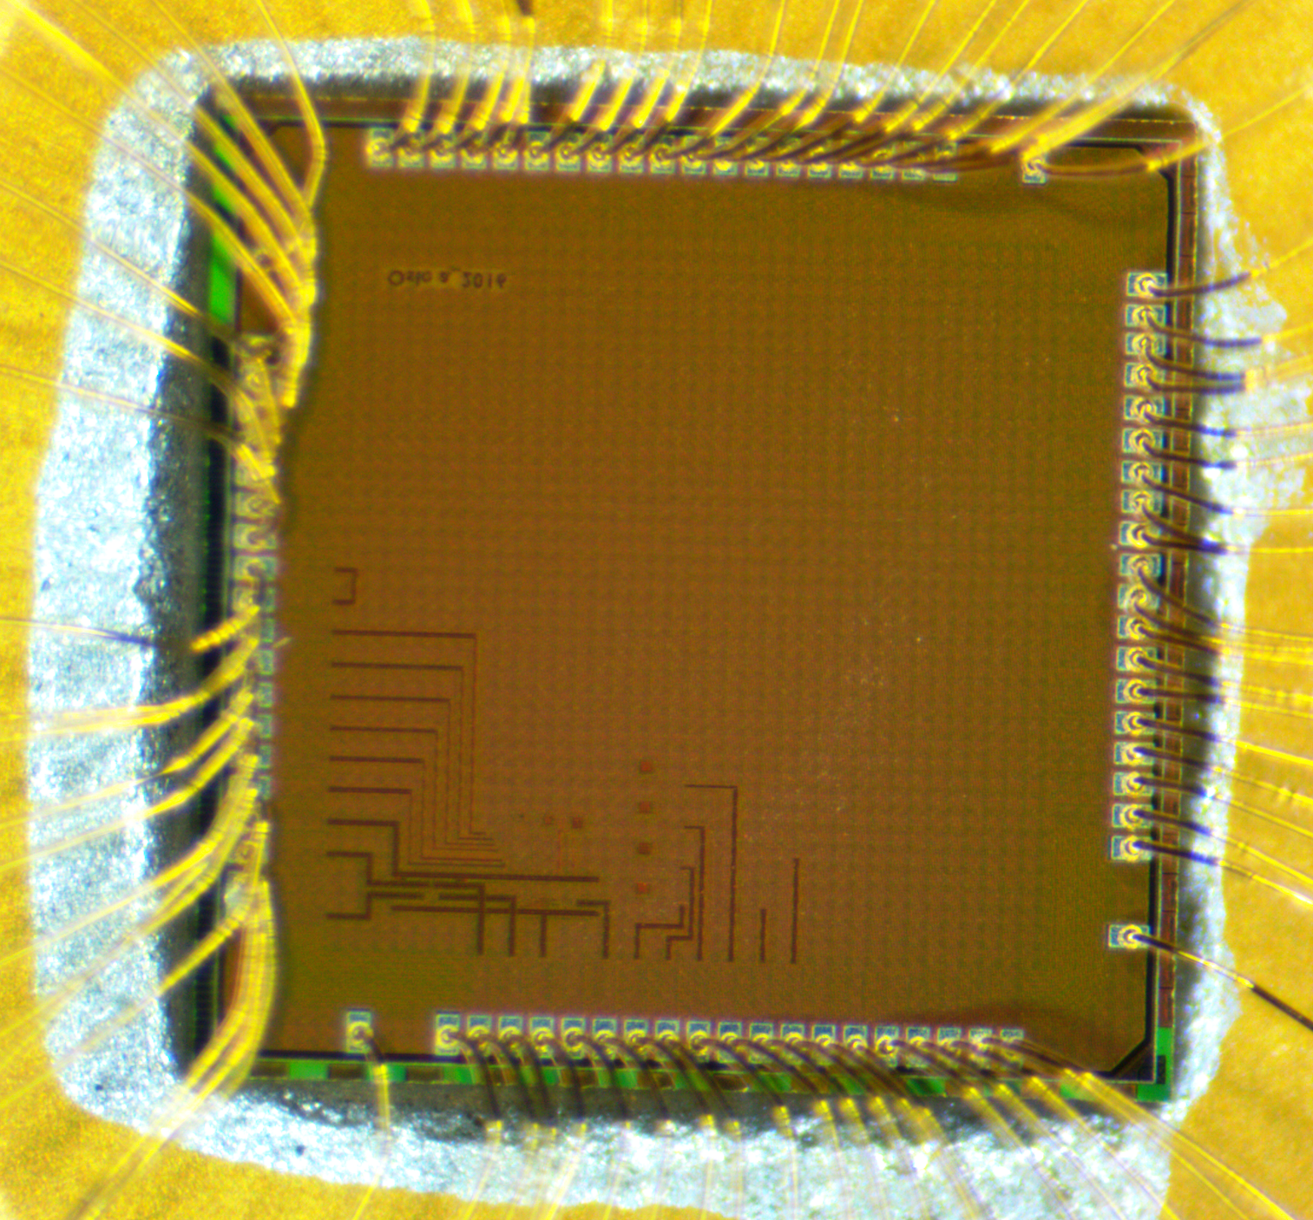
Measurements: Lab Setup
PMS Chip: CMOS 90nm 1P-9M, 2.5 V devices
PCBs: Test board, Primary and Secondary
TGA 1244, Agilent 54624A, Agilent E3648A, Keithley 6514
Matlab: control and process data

Slide 37
Measurements: Rectifier
On-board balun for Vin1 and Vin2
Potentiometer as load at Vrec
Disable LDO(!)
Drop in Vrec: bonding wire + PCB trace (+LDO conduction)
Vin1 and Vin2 distorted

Slide 38
Measurements: Vin1 Vin2 distortion, why?
Vin1 and Vin2 have peak and valley when diode is turning on and off
How: parasitic inductance and capacitance @ HF
Where:
Inductance : bonding wire + pcb trace
Capacitance: probe + pad
Effect: Multiple conduction + large reverse leakage

Slide 39
Measurements: Rectifier with various load
Large ripples, increasing with heavier load
Ripple frequency ≈ 35 MHz, more than twice input
Parasitic effect
Multiple conduction
Large reverse leakage
Substrate contacts
Capacitive coupling
Vrec over Vin1 and
Vin2 in layout

Slide 40
Measurements: Rectifier performance
VCE good, PCE reduced
Input current, use of series current sense resistor
Pin: time integral of product of instantaneous input voltage and current average over that time

Slide 41
Measurements: LDO
On-board Vref and biases
Potentiometer as load at Vreg
Disable rectifier(!)
Minimum Vin ≈ 2.45 V
Current offset 4 mA, are diodes really off?

Slide 42
Measurements: PMS
Minimum Vin ≈ 2.45 V i.e. for light load
But for 10 mA load, Vrec = 2.17 V
PMS with LDO sanity check only, rectifier only as PMS ahead

Slide 43
Measurements: WPT 5mm coupling
Resonant primary aligned over resonant secondary at 5 mm
Potentiometer as load at Vrec
Primary current lags more in phase with voltage

Slide 44
Measurements: WPT 5mm coupling performance
Decreased measured η_{wpt}
Parasitic affect in rectifier inputs
Non-optimal resonance
Load variation, rectifier non-linear load
Separation distance inaccuracy
Misalignment

Slide 45
Measurements: WPT all coupling performance
Increase coupling distance, less loading to primary, less current, higher input voltage
10 mm distance almost open load, very weak coupling
Weak coupling: link optimization should be done together with rectifier and LDO(!), new technique

Slide 46
Conclusion:
WPT implementable in 90nm
Simulation result backed by measurement
Component architecture and design choices meet the requirements
Issues mostly on layout
What can be improved:
Device size: chip area, PVT variation
Layout: wider guard ring, many many substrate contacts, separate grounds, even resistive paths, capacitive coupling, large pass device
Inductive Link: resonance shift, non-optimal resonance
PCB: proper coupling caps, symmetrical traces, test friendly
Test bench: inclusion of all parasitic, power down switches
Time management: more on layout

Slide 47
Future Works:
Application specific design:
Address the issues first
Integrate OVP and BGR
Independent WPT system
PTU
Communication and transfer protocol

Slide 48
Thank You

Slide 49
Component Design: Rectifier
Literature:
Full wave bridge rectifier
Diode connected MOSes
Voltage drop 2V_{th} + conduction drop
Gate cross coupled full wave bridge
Diode connected nMOS and gate cross coupled pMOS
Voltage drop V_{th} + conduction

Slide 50
Rectifier: Test bench
V_{in1} and V_{in2} differential inputs, 2.5 V
I_{load} = 10.5 mA
C_{rip} > 100 nF for V_{rip} < 3 mVpp

Slide 51
LDO: Stability
p1(ro_pass, Cout), p2(Resr, Cbp), p3(Ro_ea, Cgs_pass)
z1(Resr, Cout)
p1 dominant, p2 beyond UGF, p3 below UGF => unstable
Suitable Resr and large Cout to cancel p3 with z1, left half plane zero

Slide 52
LDO: Test bench
Vrec = Vin > 2.15 V
Vref, bandgap of Si = 1.177 V
Vbias2, Vbias3, Vbias4 = 1.1 V, 0.88 V, 0.68 V respectively
Cload > 2.5 uF and Resr > 0.5 Ω
Cbp = 10 nF
Iload = 10 mA

Slide 53
LDO: Stability and PSSR
Stability
PSSR
3 poles: 2 below UGF, 1 above
Zero to cancel non dominant pole
PSSR:
Good at LF with high open loop gain
Low at HF, reduced UGF after stability

Slide 54
PMS: Rectifier + LDO

